Slide 1
Titanium Scientific Bureau
For Pharmaceutical And Medical devices In Iraq

Slide 2
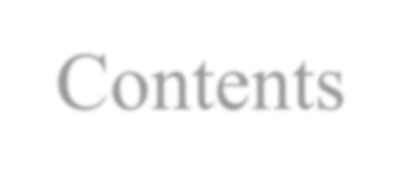
Contents
About us
Our Vision , Mission and Value
Our Structure Partners
Medical & Sales Representative
Customers Contact

Slide 3
About us
Titanium Scientific Bureau is one of the important scientific bureau which was established in Baghdad, have head offices in both Baghdad & Erbil , specialized in marketing and distribution of pharmaceutical, medical and food supplement products in Iraqi market.
We are registered in accordance and in compliance with the rules and regulations issued by the syndicate of Iraqi pharmacists and MOH.

Slide 4

About us
* We supply private market with various of pharmaceutical ➢ products form companies we represent , we are a dictated team with full experience in pharmaceutical field .
* Titanium Scientific Bureau managed to register the ➢ pharmaceutical companies along with their products as we have efficient team at the regulatory that facilitate our achievement in short period we act as sole agency for our companies and we represented in the North of Iraq
( Kurdistan Region ) by Sharez company to reach all the North area

Slide 5
Our Vision , Mission and Value
Vision :
Our vision is to be in the forefront among all pharmaceuticals agencies in Iraq being recognized through our highlyqualified products, variety of services and promotional and marketing teams that reach the most distant of Iraq’sprovinces, areas and districts.
Mission :
By providing the high-quality healthcare products for patients with affordable prices, elegant services for the customers and fulfilling perfect working environment for our teams.

Slide 6
Our Vision , Mission and Value
Value :
Our values represent the basis for the development of our business.
Integrity as the basis for any successfulbusiness.
Focus on consumer is a fundamental ingredientfor our success.
Developing the team is essential to sustain ourgrowth.
High performance is what we strive for permanently.
Quality in our product and Excellence in our processes.
Commitment to diversity and the acceptance of diferences.

Slide 7
Structure
Titanium Scientific Bureau
General Manager
Regulatory
Team In MOH
Executive Director
Operations & Supply
H.R
I.T
Finance
Marketing
Sales
Business
Support
Wareh ouse
Customers
oms

Slide 8
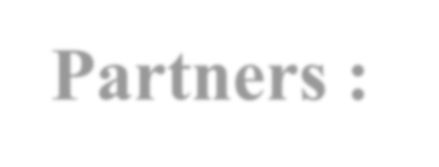
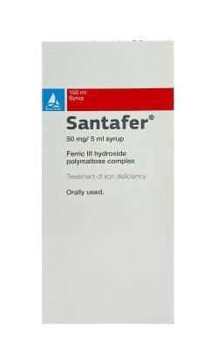
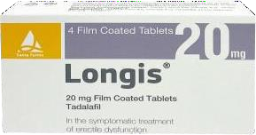
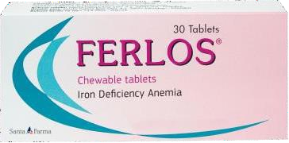

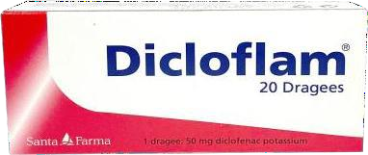
Partners :
Santa Farma / Turkey :
Santa Farma Ilac Sanayii was founded in 1947. The Company's line of business includes the manufacturing, fabricating, or processing of drugs in pharmaceutical preparations for human or veterinary . It offers medicines for dermatology, muscle, digestive system and metabolism, hematology, radiology, nervous system, and more.
Products :

Slide 9






Partners :
Life – On Healthcare / UK :
Life-On Healthcare Ltd. is a dietary supplements company based in London. After years of researching the market, working with expert health researchers and formulation specialists, our formulations of dietary supplements bring well-being and health benefits to you and your family. Life On Healthcare, striving to excel human lives, was established in this background to bring about high quality and scientifically validated nutritional health supplements with premium quality ingredients providing improvement in wellness of life, health and fitness.

Slide 10

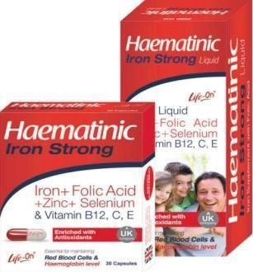
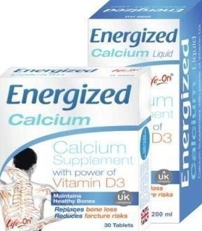


Partners :
Life – On Healthcare :
Products

Slide 11

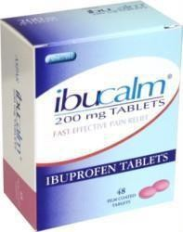

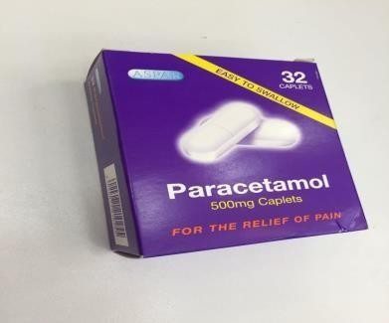
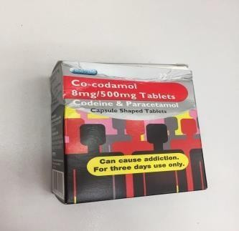
Partners :
Aspar pharmaceutical / UK :
We are a major supplier of analgesics to the British pharmacy and grocery sectors throughout the UK. Through a consistent program of investment and innovative management, Aspar has become
one of the UK’s specialist pharmaceutical manufacturing and contract packers. By controlling growth
we are able to respond quickly to the needs of our customers, giving them the first to market advantage.

Slide 12

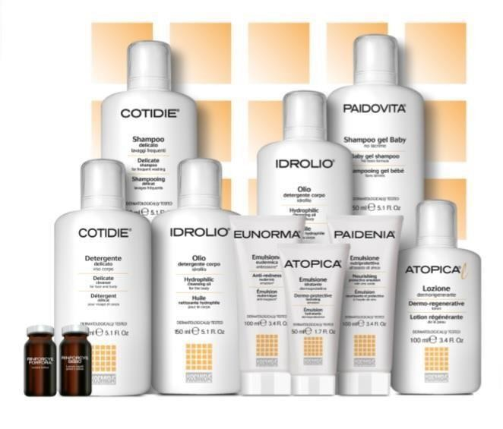
Partners :
OFI Officina Farmaceutica Italiana SpA / Italy :
OFI is one of Europe’s foremost companies in the development and manufacture of dermo- cosmetic and dietary-nutritional products. Quality, reliability and a powerful innovative drive are the strong points recognized by the market and professionals in the sector.

Slide 13
Contact:
Titanium Scientific Bureau
Head office :
Baghdad-Iraq
Al-karrada – Sena’a St.
Dist. 906 – Str. 50 - Building no.10 .
Tel: +9647822210666
Email: head-office@titaniumiraq.com
Titaniummanager1@gmail.com

